Slide 1

Dual Object Detection using YOLOv12
Kangaroo & Drone Recognition for Environmental and Aerial Safety

Slide 2
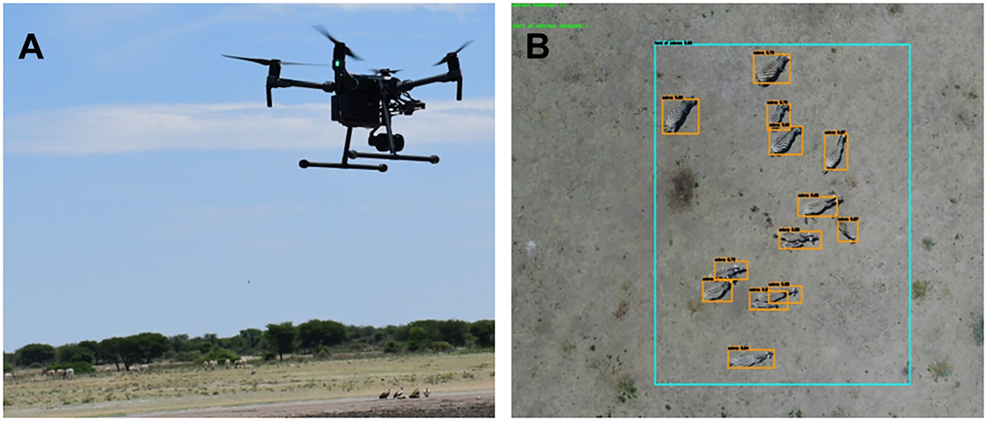
Project Background
CSIRO relies on drones to track wildlife and monitor ecosystems.
Manual analysis is time-consuming and error-prone.
AI vision models enable real-time biodiversity tracking and aerial monitoring.
Need for a unified AI solution supporting both ground and air data.
Notes:
Speaker cue: Introduce CSIRO context + why AI is essential for field automation.

Slide 3
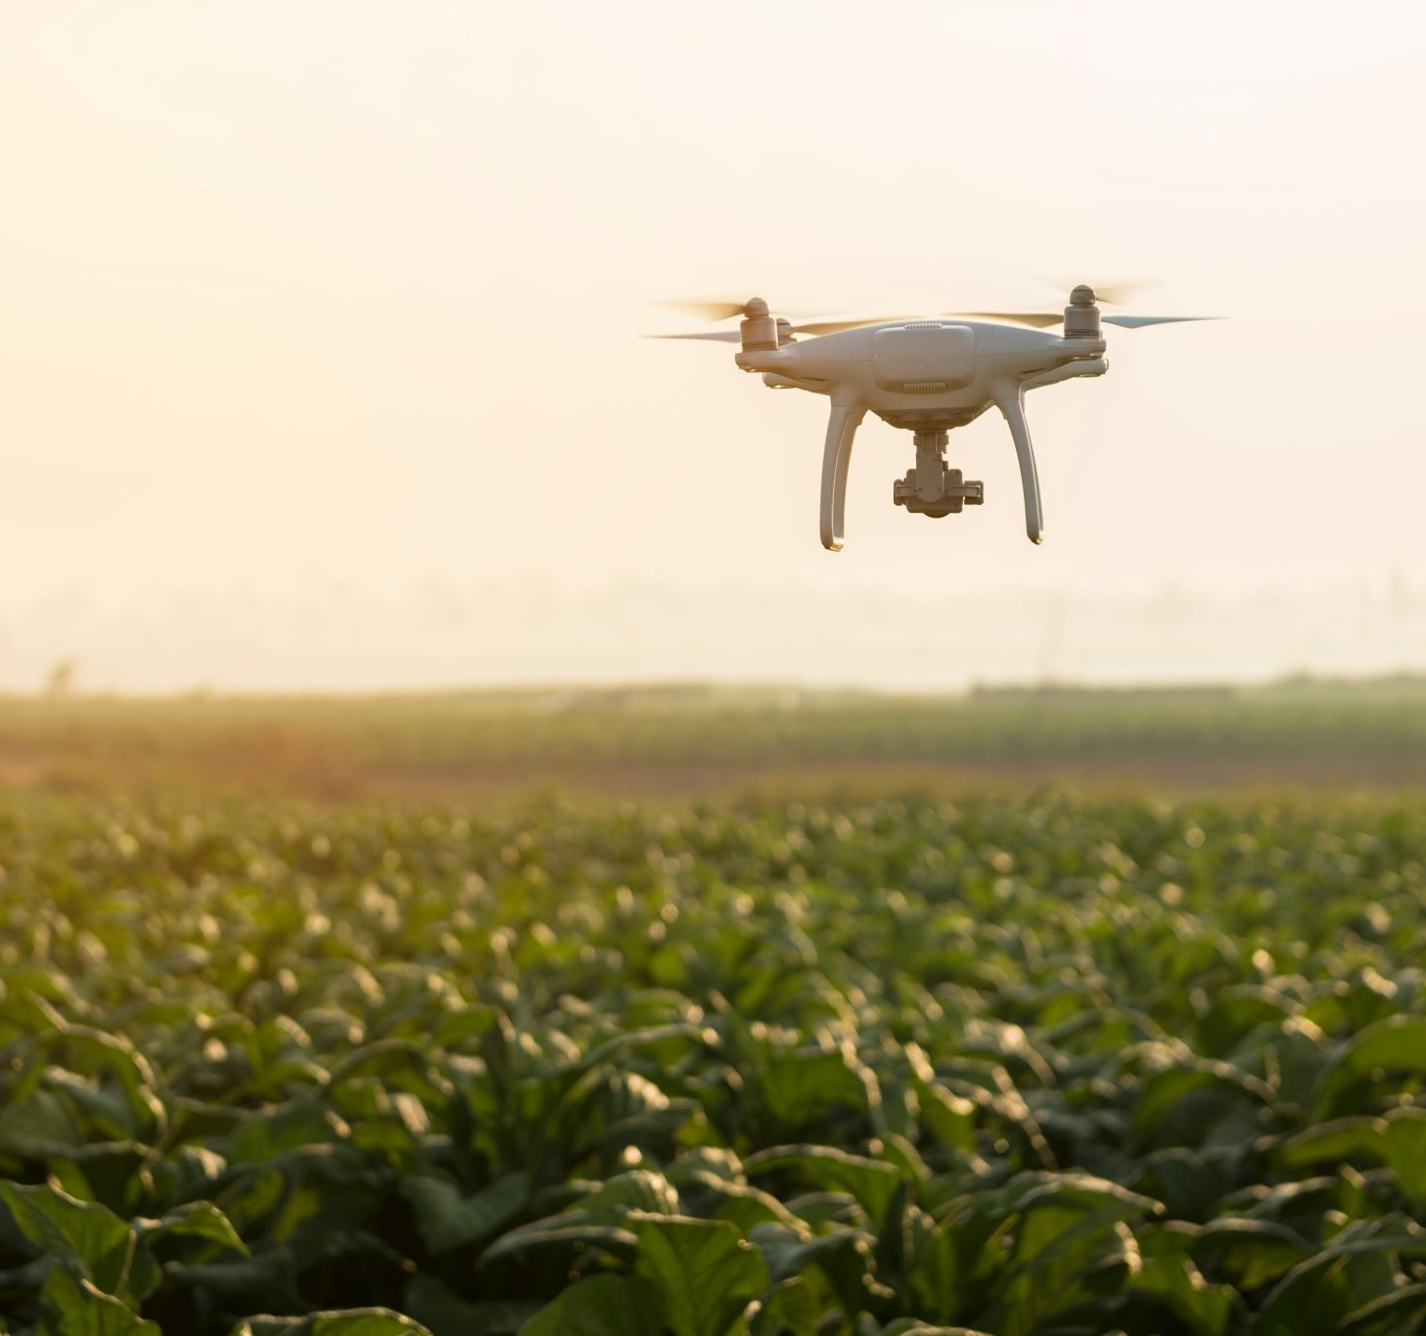
Problem Statement
CSIRO faces challenges in automating drone and wildlife detection for large-scale environmental monitoring and airspace safety. Current manual methods are slow, inconsistent, and not scalable, limiting timely analysis and operational efficiency.
Key Challenges:
Manual image review is time-consuming and error prone.
Large areas make consistent monitoring difficult.
Lighting and weather variations reduce detection accuracy.
No consistent AI pipeline existed to handle both drone and wildlife detection efficiently.

Slide 4
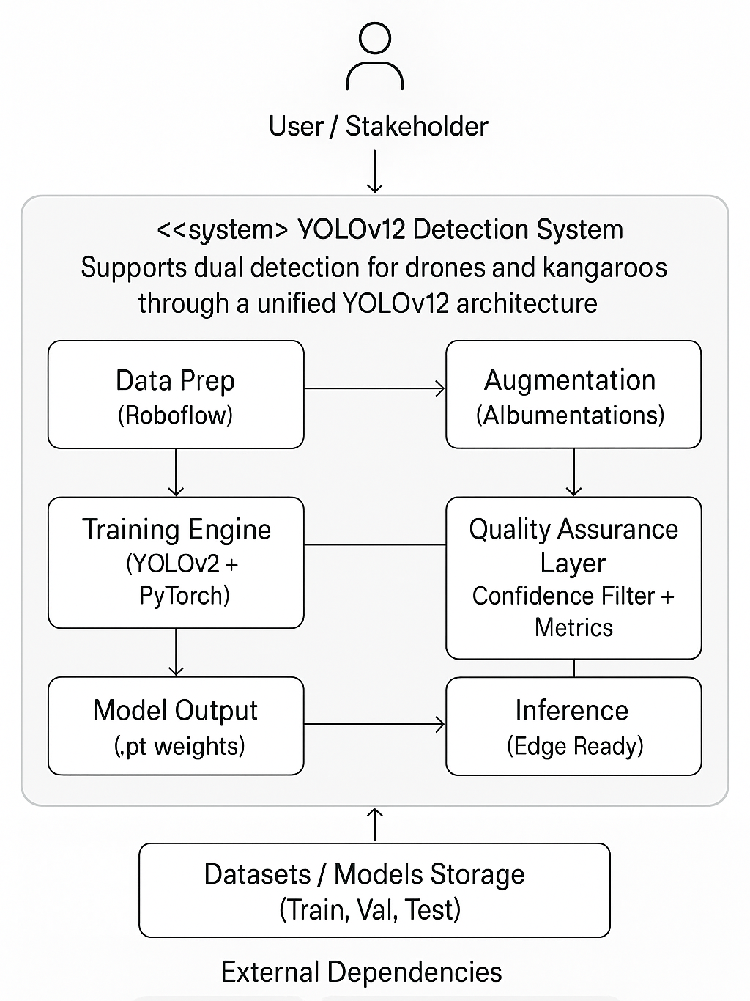
Proposed Solution – YOLOv12 Dual Detection System
A unified YOLOv12-based detection system was developed to perform
dual detection for both drones and kangaroos through an automated AI pipeline.
Core Highlights:
Dual Detection - Single model identifies drones and kangaroos.
Smart Augmentation - MixUp, Mosaic, CutMix, Weather, and Perspective enhancements.
YOLOv12 + PyTorch - High-accuracy training with real-time validation.
Quality Filtering - Removes low-confidence samples below 70%.
Edge-Ready - Optimized for field and on-device inference.

Slide 5

Client Value & Impact (CSIRO Relevance)
This unified AI system directly supports CSIRO’s goal of sustainable, data driven innovation in environmental and aerial research.
Key Benefits
Efficiency - Automates detection, saving time and resources.
Accuracy - Confidence-based filtering ensures reliable results.
Cost-Effective - One model for both drones and wildlife.
Sustainable - Enables non-intrusive environmental monitoring.
Scalable - Easily extendable to new species and aerial targets.
Impact Achieved
Drone Model – 95.9% mAP accuracy
Kangaroo Model – 86.6% validation accuracy
Reusable, high-quality AI pipeline ready for CSIRO deployment

Slide 6
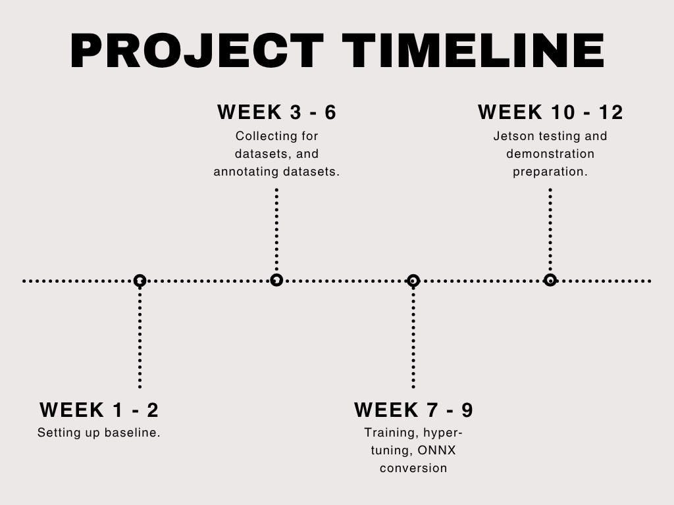
Deliverables & Milestones
Week 1–2: Baseline environment verification.
Week 3–6: Dataset collection and annotation.
Week 7–9: Training, hyper-tuning, ONNX conversion.
Week 10–12: Jetson testing and demo preparation.
All milestones completed on schedule.
Notes:
Summarize project progress and how agile planning kept team on track.

Slide 7
Implementation Details
Kangaroo Dataset
Initial Setup:
Source: William provided 543 images
Preprocessing: Augmented & labeled in Roboflow
Train/Val Split: 80/20
Train: 434 images
Validation: 109 images
First Training Round:
Trained YOLOv12 model
Tested on validation set
Quality Control: Removed 16 low-confidence images (<0.5)
Final Dataset:
527 high-quality images
Ready for production
Drone Dataset
Round 1 - Initial Training:
Source: William provided 259 labeled images
Sonal: Split 80/20
Train: 207 images
Validation: 52 images
Sonal: Trained YOLOv12 model
Sonal: Tested on validation set
Sonal: Removed 3 low-confidence images (<0.5)
Round 2 - Augmented Retraining:
Sonal gave 49 images to Manindu for augmentation
Manindu's augmentation: Applied MixUp, Mosaic, CutMix, weather effects, perspective changes
Manindu's result: ~400 augmented images
Manindu returned augmented dataset to Sonal
Sonal: New 80/20 split and retrained
Sonal: Final Quality Check - 0 images removed - all detections >0.5 confidence

Slide 8
DEMO VIDEO

Slide 9
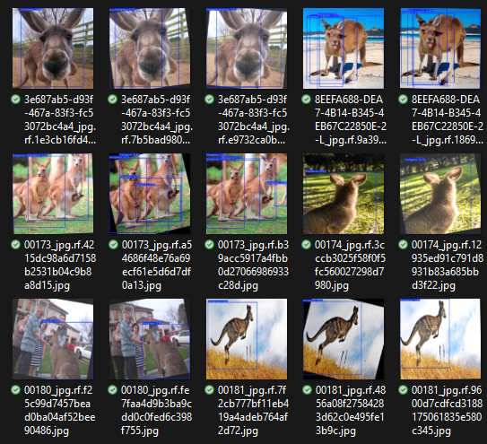
Evaluation / Results
Drone Precision ≈ 85 %,Kangaroo Precision ≈ 79 %.
Higher mAP than YOLOv8 for small object detection.
Consistent loss reduction across epochs.
Clear bounding boxes on test frames.
Notes:
Speaker cue: Briefly walk through metrics and showcase example outputs.

Slide 10
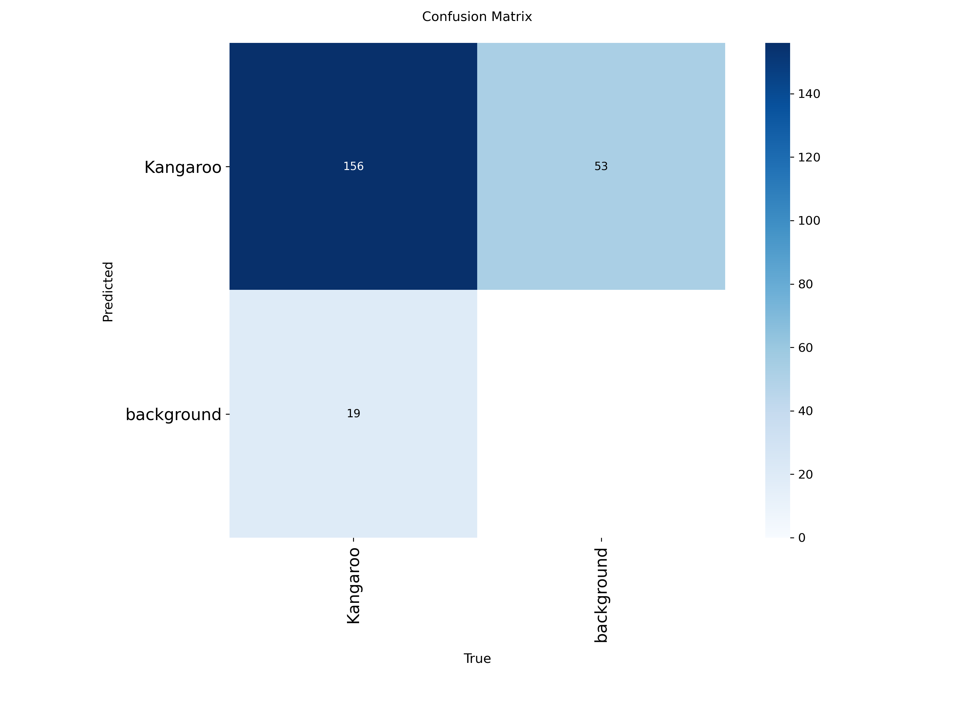
Quality Assurance / Testing & Validation
80 / 20 train-val split within dependent evaluation.
Peer label reviews and error logging.
Cross-validation and stress testing on unseen images.
Risk register for hardware andannotation issues.
Notes:
Speaker cue: Explain how QA ensured model reliability and reproducibility.

Slide 11
Future Scope + Impact Summary
Future Enhancements
• Real-Time Detection: Expand from image-based to live video analysis.
• Multi-Object Tracking: Enable tracking across sequences, not just single frames.
• Species Classification: Extend to identify specific drone types or kangaroo species.
• Mobile & Edge Deployment: Adapt models for Raspberry Pi, Jetson, and mobile apps.
• 3D Detection: Advance from 2D bounding boxes to full spatial localization.
Recommendations
• Dataset: Expand Kangaroo dataset (1,000+ images) and include varied lighting & weather.
• Model: Test larger YOLO models (YOLOv11 series) and enable continuous learning.
• Deployment: Develop a cloud API and web dashboard for real-time monitoring.
• Quality Assurance: Schedule regular retraining, monitor model drift, and gather feedback.
Impact & Next Steps
• Drone: 95.9 % mAP accuracy
• Kangaroo: 86.6 % validation accuracy
• Outcome: Reusable AI pipeline ready for CSIRO deployment.
• Next Step: Pilot deployment with continuous improvement and dataset expansion.

Slide 12
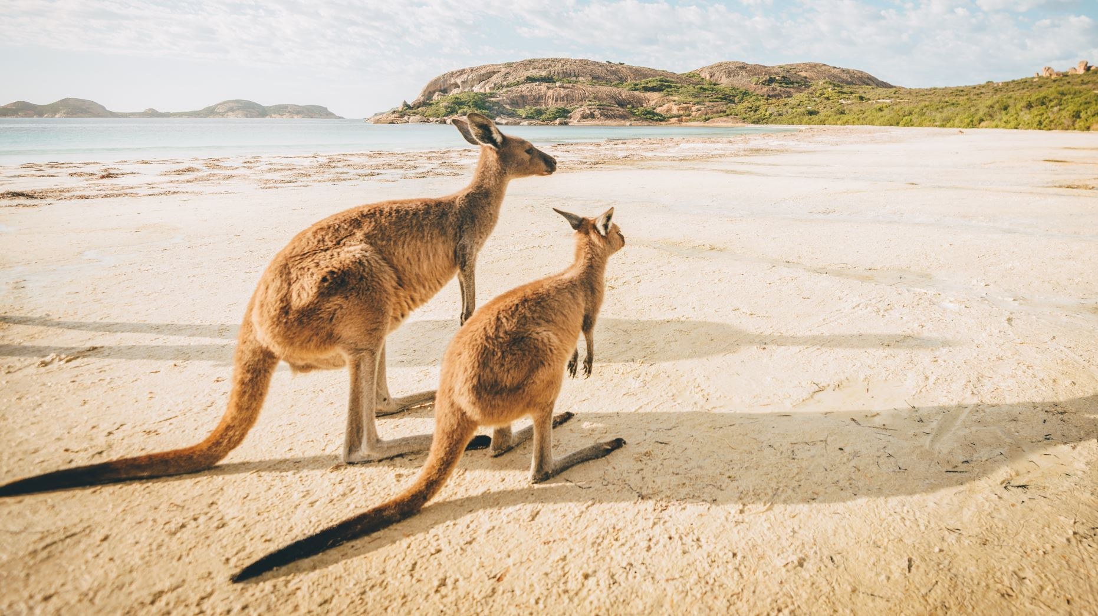
THANK YOU!

